Slide 1
Lake Shore High School
English Department
Course Offerings 2018/19

Slide 2
Literature and Rhetoric A,B,C (1.5 Credits)
Grade 9
Three sections required

Slide 3
American Literature A,B,C (1.5 Credits)
Grade 10
Three sections required
Course content will include “The American Tradition: Contemporary Realistic Fiction”, informational reading selections, parts of speech, and sentence structure, persuasive, comparative and reflective essays, talk to the text, peer editing, think aloud, making predictions, writing fluency, guided highlighted reading, literary terms, modern American drama, non-fiction literature, the novel, close and critical reading, marginalia, Transcendentalism, graphic organizer, poetry, characterization, and extensive vocabulary development. These courses are aligned with the Michigan Common Core State Standards for English language Arts. The CCR standards, and high school grade-specific standards, work in tandem to define college and career readiness expectations. Standards are defined as Reading Standards for Literature, Writing Standards,

Slide 4
British Literature A,B (1.0 Credit)
Grade 11
Two sections required
British Literature A
In this required course, we will read, write about, and discuss BRITISH LITERATURE from the 5th to 17th centuries. We will examine how literature reflects its culture and examine the universal human condition that transcends time and place. Along with some short stories and poetry, we will focus on Beowulf, The Canterbury Tales, and Hamlet. We will write daily. We will hone our Rhetorical Analysis skills.

Slide 5
British Literature B
In this required course, we will read, write about, and discuss BRITISH LITERATURE from the 17th to 20th centuries. We will examine how literature reflects its culture and examine the universal human condition that transcends time and place. Along with short stories and poetry, we will enjoy either Mary Shelley’s Frankenstein or George Orwell’s 1984.
Writing will be a primary focus in British Literature B; we will write every day. You will be required to incorporate 11th grade vocabulary, spelling, and grammar skills in your in-class assignments, essays, narratives, compositions, and story/character analyses. We will examine and develop strategies for RHETORICAL ANALYSIS. Most important, we will spend the time writing a research essay.

Slide 6
Advanced Placement English Courses

Slide 7
Why Should I take an AP English class?
You want to join the discussion on some of the nation’s most pressing issues.
A high AP Exam score will allow you to waive intro English classes in college
Potential to boost your GPA by exceeding a 4.0
Academic rigor is attractive to colleges
You want to expand your knowledge about literature and the world around you
You can earn extra financial aid or have more scholarship opportunities

Slide 8
Advanced PLacement Language & Composition (11-12)
College level writing course. You can potentially earn college credit.
Mostly nonfiction--current events, essays, op-eds, arguments.
Analyze the effects of diction, syntax, rhetorical devices, assumptions, evidence, and claims.
Helps prepare for SAT writing and analysis (The College Board writes the SAT and the AP tests!)
Write your own well-informed arguments about issues and ideas that are currently part of the national conversation.

Slide 9
Advanced Placement English Literature and Composition (Grades 11-12)
College level literature - reading and analysis
Independent and class novels
Short stories and poetry
In-depth study of literary periods, styles, and techniques
Writing assignments will include paragraphs, timed essays, formal essays, journal entries, imitative writing, and creative writing.

Slide 10
12th Grade English Credits OR English Electives

Slide 11
Modern Fiction and Literature (.5 Credit toward Senior English Requirement OR English Elective)
Grade 12
This course will present and explore in detail the major themes, ideas, and messages presented in a few selections of our modern literary classics; including an exploration of the ideas of Self-Discovery, Alienation, Moral Values, as well as the Human Condition. The class will also make allusions and connections to previously read material as well as analyzing the styles, times, and literary techniques of these outstanding 20th century writers. This course can be taken without a co-requisite of Contemporary Topics & Memoirs.

Slide 12
Contemporary Topics and Literature (.5 Credit toward Senior English Requirement OR English Elective)
Grade 12
This course will cover some of the commonalities, themes, and major ideas found in the genre of non-fiction writing and will include selections from several modern literary classics. Book choices will explore riveting first person accounts of struggle and survival, activism, personal growth and multiple emotional and psychological Points-of-Views. The class will also explore Abstract Ideals, Compassion, and the power of the written word. We will also analyze the styles, times, and literary techniques of these outstanding 20th century citizens and we will examine what is unique about each of these memoirs and realize the universal truths about ourselves through literature. This course can be taken without a co-requisite of Modern Fiction & Literature. This course can be taken without a co-requisite of Modern Fiction & Literature.

Slide 13
Film and Literature (.5 Credit toward Senior English Requirement OR English Elective)
Grades 11 & 12
This is a hybrid class which means we meet 3 days a week, giving you time to complete the reading selections at your leisure.
We read short stories then compare and contrast them with the film version of the story.
This is an English Credit, so you will be asked to write reflections on the films we view, and the literature we read for both personal as well as technical aspects.

Slide 14
Film in Our World (.5 Credit toward Senior English Requirement OR English Elective)
Grades 11-12
Film in Our World encompasses much more than watching movies.
We will discuss how movies are used to make statements about life and how certain techniques such as camera shots and camera angles are used to convey a message or mood.
We will study the Narrative of film and how all these techniques are used to tell a story, develop characters, and relate the story to audiences.
We will look at some of the different genres of film to learn how the Narrative is developed in different types of movies.
You will also be introduced to careers in the film industry that you never thought existed.

Slide 15
Greek Mythology (.5 Credit toward Senior English Requirement OR English Elective)
Grades 11-12
Course content will include the study of major Greek and Roman gods, the Palace of Olympus, nature myths, love stories, the underworld Greek heroes, and the study of literature-based vocabulary. This class is recommended for the proficient reader who seeks to further his/her knowledge and appreciation of literature. Students will develop strong note taking skills. Creative and analytic papers will be emphasized.

Slide 16
Mass Media (.5 Credit toward Senior English Requirement OR English Elective)
Grades 11-12
Course content will include advertising, propaganda, film and review, television and critiquing, periodical analysis, and social impact of the media. Students will become familiar with the impact of mass media on society. Activities will include readings, current events, research, class discussions, writing, interpretation, analysis, oral participation and objective evaluation.

Slide 17
Public Speaking (.5 Credit toward English Requirement OR English Elective)
Grades 10-12
This class is designed to provide you with basic theories and skills that are essential to effective public speaking.
Skills include:
the process of communication
listening skills
audience analysis
organization of ideas
Persuasive and informative speaking
Extemporaneous delivery
Overcoming the fear of speaking in front of an audience
Special Occasion

Slide 18
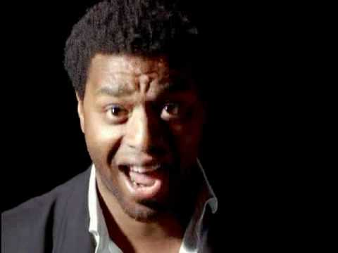
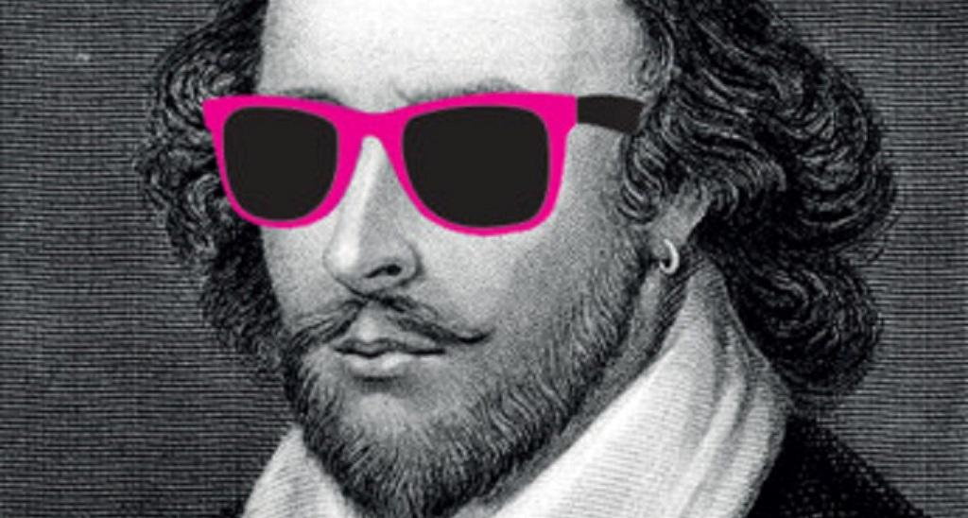
Shakespeare (.5 Credit toward
Senior English Requirement OR English Elective)
WATCH ME!!!!
Grades 10-12
This course provides students an opportunity to study the plays and sonnets of William Shakespeare. The focus will be on a variety of Shakespeare's tragedies, comedies, romances, and histories as well as Shakespeare's sonnets. The class emphasis will be on close reading, Socratic discussion and analysis of universal themes. Students will formally and informally present their ideas and knowledge through various writings and presentations, including live performance.

Slide 19
The Shoreline (.5 Credit toward Senior English Requirement OR English Elective)
Grades 9-12
http://www.lshsshoreline.org/
The students in this class produce the LSHS online publication, The Shoreline.
An emphasis will be placed on writing. Students who take this course must enjoy writing and be willing to improve with the help of editors.
Students with a skill for web design and Photoshop are also needed.
This class looks great on a college application!

Slide 20
Short Story (.5 Credit toward Senior English Requirement OR English Elective)
Grades 11-12 - Course content will include vocabulary, essay writing, short story evaluation, American and European authors, characterizations, settings, plots, and traditional literary devices. Classic and contemporary social themes will be explored. Students will study classical and contemporary authors and investigate both fiction and non-fiction works. Story selections reflect universal themes such as teen issues, relationships, making choices and others. Creative writing will be incorporated as a response to the literature.

Slide 21
Creative Writing (.5 Credit toward Senior English Requirement OR English Elective)
Grades 11-12
Skills Include:
Put your creative ideas into writing
Poetry, narrative writing, short stories
Constructive critique, revision, and publishing in writing groups
Digital portfolio creation

Slide 22
Visual/Performing Arts

Slide 23
Introduction to Drama (.5 Credit toward Visual/Performing Arts Credit)
Grades 9-12

